Slide 1

Financing the un-financed (Social Financial lending)

Slide 2

MOTIVATION
Financing or loans are essential for any community. Today,banks are desperate to provide loans to individuals having good tracking financial/credit history. But many people are not part of this system, they don't have trackable financial history and thus Banks are reluctant to offer loans to them. And these people are often exploited by local untrustworthy lenders.
Idea is to predict borrowers' repayment capability by using other easily available dataset like telco and transactional information. The problem is to predict loan pay-ability using various statistical and machine learning methods on the provided data set.
We want to enable the banks to decide whether the borrower will be able to pay the loan back on the basis of different factors related to the borrower’s social and financial status.

Slide 3

DATASET USED AND CHALLENGES
Data is present in the form of a csv file for training and testing (with TARGET) . Data is static data for all applications. One row represents one loan in data sample.122 different columns are present in the dataset which provide the value for the different social and financial factors related to the borrower. The borrower is identified uniquely by the SK_ID_CURR column values. Some of the challenges are :
1. Data may also be corrupt (some of mandatory fields are missing),need to filter/impute those records. 2. Data was collected from multiple sources hence it may contain duplicate records, needed to clean up duplicate records. 3. Highly imbalanced dataset for the target values.

Slide 4
PACKAGES USED
PROGRAMMING LANGUAGE USED : PYTHON
DATA WRANGLING : PANDAS, NUMPY
DATA VISUALIZATION : MATPLOTLIB,PLOTLY
TREND ANALYSIS & MACHINE LEARNING : SCIKIT LEARN
HANDLING IMBALANCED DATA : IMBLEARN(ADASYN)
ENSEMBLE METHODS : RANDOM FOREST
VALIDATION METRICS : r2_score,Confusion Matrix, Classification Report, AOC

Slide 5
DATA WRANGLING
STEPS USED IN DATA WRANGLING :
Converted the categorical columns into binary format (0,1) using get_dummies method.
Some of the values for days were in negative,so changed them to positive using the .abs method
Found out the outliers and removed them by defining a proper ranges for column values(e.g. Maximum Employment years = 45 )
Changed the time period values from days to years for better visualization.
Defined ranges for the amount related columns in order to standardize the value ranges.
Found out the NaN values in the different columns and tried to impute them using different imputation techniques (Sklearn Imputer)

Slide 6

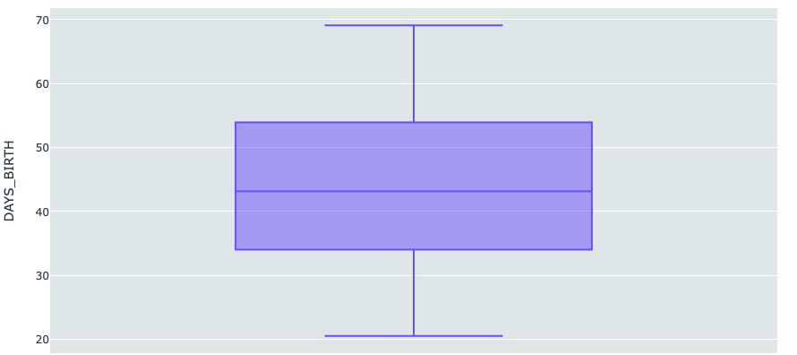
EDA
Below are the different plots used for different columns to get the relation between them and the target variable.
Box plots were used to get the ranges for the columns representing time. E.g. Below box plot shows the range for age of the borrower

Slide 7
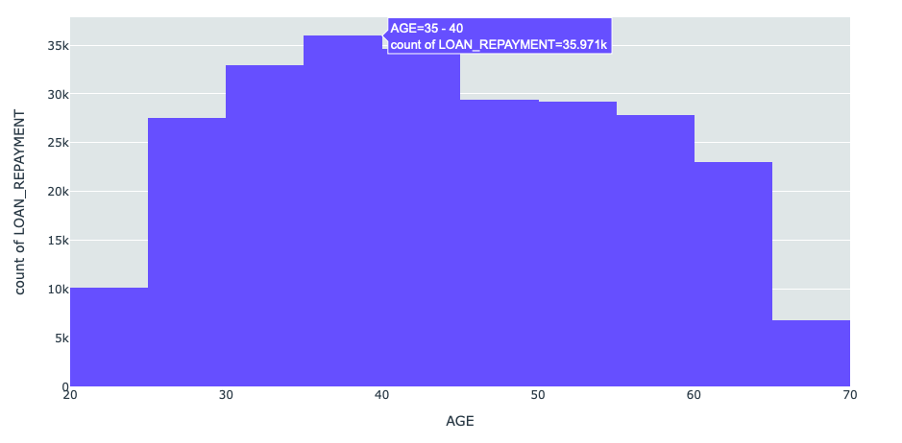
The age of the borrower was a big factor that was responsible for loan repayment by them. The below histogram shows the variation of the number of people paying the loan back as per their age.

Slide 8
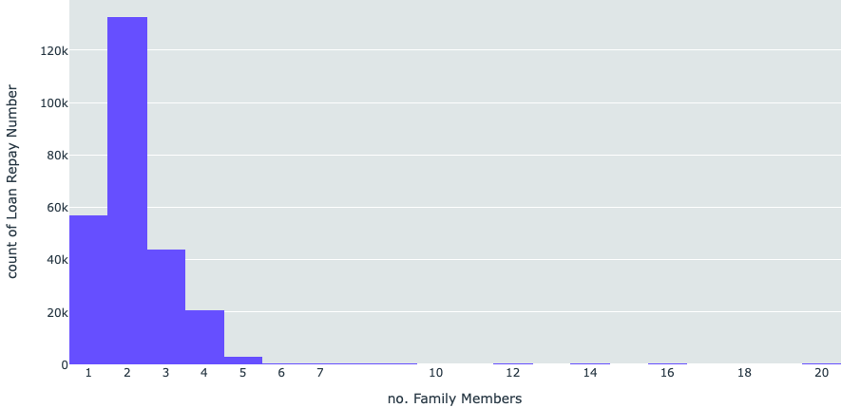
Similarly, the number of family members in the family also affects the loan repayment capabilities of a borrower significantly as show by the histogram below. Lesser the family members, better the probability of the person paying back the loan.

Slide 9
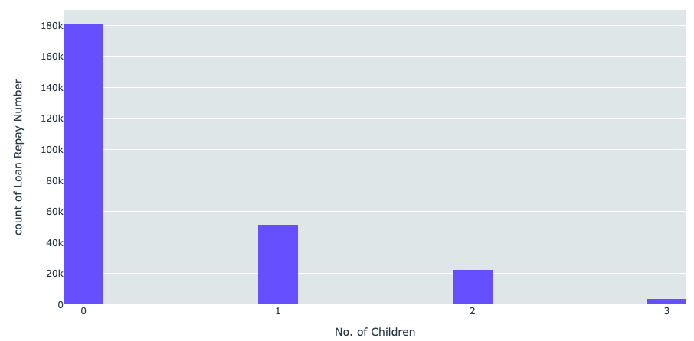
As seen below, the increase in number of children directly results in the downfall of a person’s ability to repay the loan.

Slide 10
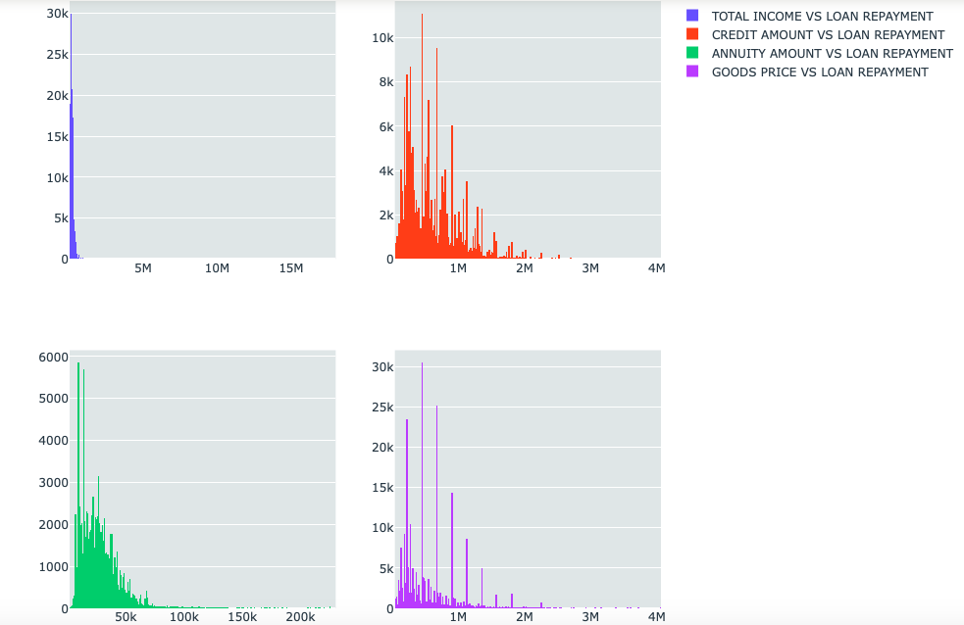
As expected, the financial situation of the borrower is also a big factor in deciding that whether he/she will repay the loan availed. Below plots compare the different financial sources with the number of people repaying the loans.

Slide 11
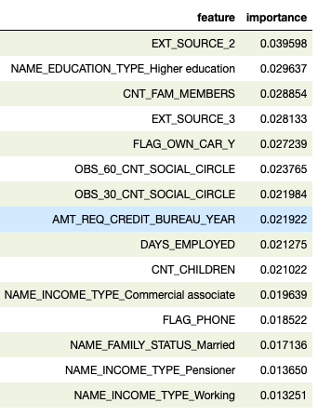
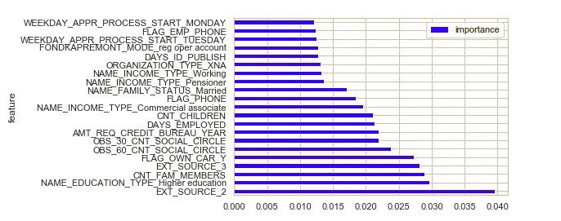
As per the data provided and after calculating the correlations, below 15 variables are the most responsible factors that decide a person’s ability of paying back the loans.

Slide 12
DATA IMPUTATION
Used KNN technique to replace the NaN values in the columns. Steps taken are as below :
Took out the NaN values from the columns of the dataframe.
Took out the columns having the NaN values and made a separate list. The rest of the columns were used as parameters.
Used the dataset of the parameters as X_train(Data) to train the KneighborsRegressor with the columns having the NaN values(NaN removed) used as Y_Train(Features).
Used the above model to predict the values for the NaN columns.
Replaced the predicted values in the original dataframe to eliminate the NaN values.

Slide 13
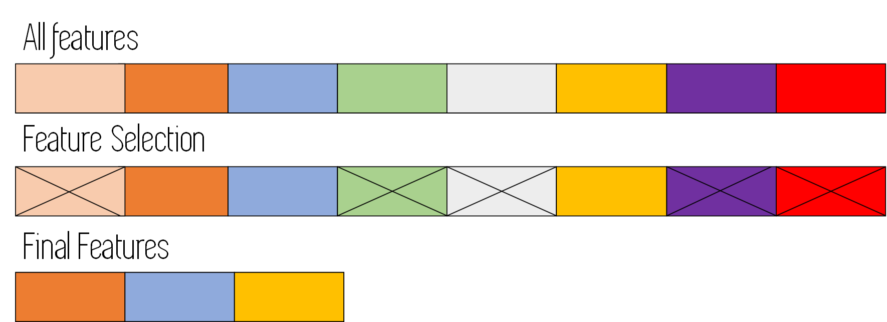
FEATURE SELECTION
STEPS TAKEN FOR FEATURE SELECTION :
Created a list of all the categorical variables
Used the Chi Square and p value method to get the relative importance of the variables in deciding the target variable on a 95 % confidence interval.
Considered a Null hypothesis that the variables are not affecting the Target variables at all and separated the variables on the basis of which satisfy the nUll hypothesis and which reject it.
Trained the Model on the variables which reject the hypothesis and prove that the target variable actually depends on them.

Slide 14
CLASSIFICATION MODELS
1 . Logistic regression :
Results:
Tuned Model Parameters: {'C': 1.0, 'penalty': 'l2', 'tol': 0.0001}
Best score is 0.918955053389837
2. Random forest Classifier
Results :
Tuned Model Parameters: {'criterion': 'entropy', 'max_features': 'auto', 'min_samples_leaf': 1, 'n_estimators': 100}
Best score is 0.9365974986234322
3. Decision Tree Classifier
Results :
Tuned Model Parameters: {'criterion': 'gini', 'min_samples_leaf': 10, 'splitter': 'random'}
Best score is 0.9072329660340431

Slide 15
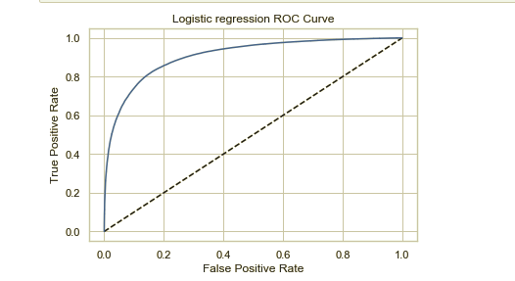
Performance Validation
Below is the ROC curve for the model when trained on Random Forest Classifier

Slide 16

FINAL RESULTS
The results give the ID of the borrower along with the possibility of the borrower of paying the loan back as a final result. The model is capable of taking in the data and give out the possible results enabling the banks to finance the people for whom they don’t have a significant amount of data and credit history.

